Slide 1
Stanford ME469: Advection Operators and Residual-Based Schemes
Stefan P. Domino
Computational Thermal and Fluid Mechanics
Sandia National Laboratories SAND2018-4536 PE

Slide 2
Advection Operators: Outline
Classic Analysis on Advection/Diffusion/Time Scalar Transport
Diagonal Dominance
Upwind Methods
Linear Residual-Based Stabilization
Nonlinear Residual-Based Stabilization
Conclusions

Slide 3
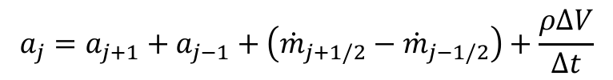
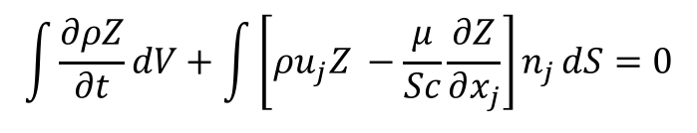
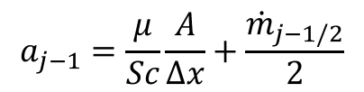
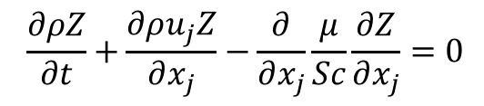
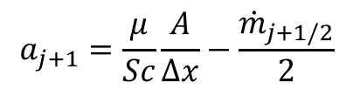
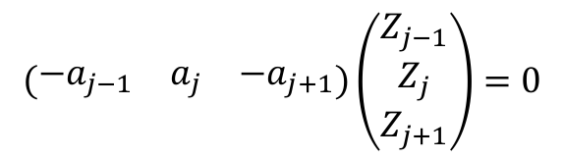
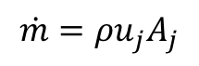
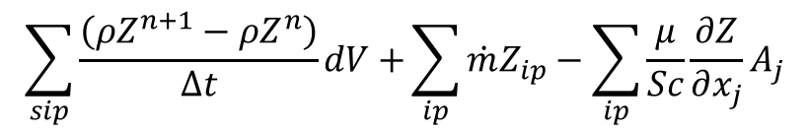
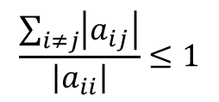
Consider a Simple Advection/Diffusion/Time Scalar Transport
$$\frac{∂ρZ}{∂t}+\frac{∂ρu_{j}Z}{∂x_{j}}−\frac{∂}{∂x_{j}}\frac{μ}{Sc}\frac{∂Z}{∂x_{j}}=0$$
PDE is given by:
Integral form:
Discrete form:
Matrix Form:
$$\int{\frac{∂ρZ}{∂t}dV+\int{\left[ρu_{j}Z −\frac{μ}{Sc}\frac{∂Z}{∂x_{j}}\right]n_{j}}dS=0}$$
$$\sum_{sip}{\frac{\left(ρZ^{n+1}−ρZ^{n}\right)}{Δt}dV+}\sum_{ip}{\dot{m}Z_{ip}−\sum_{ip}{\frac{μ}{Sc}}}\frac{∂Z}{∂x_{j}}A_{j}$$
Mass flow rate:
$$\dot{m}=ρu_{j}A_{j}$$
$$\left(\begin{matrix}−a_{j−1} & a_{j} & −a_{j+1}\end{matrix}\right)\left(\begin{matrix}Z_{j−1} \\ Z_{j} \\ Z_{j+1}\end{matrix}\right)=0$$
$$a_{j+1}=\frac{μ}{Sc}\frac{A}{Δx}−\frac{{\dot{m}}_{j+1/2}}{2}$$
$$a_{j−1}=\frac{μ}{Sc}\frac{A}{Δx}+\frac{{\dot{m}}_{j−1/2}}{2}$$
$$\frac{\sum_{i≠j}{\left|a_{ij}\right|}}{\left|a_{ii}\right|}≤1$$
$$a_{j}=a_{j+1}+a_{j−1}+\left({\dot{m}}_{j+1/2}−{\dot{m}}_{j−1/2}\right)+\frac{ρΔV}{Δt}$$
j-1
j
j+1

Slide 4
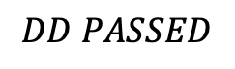
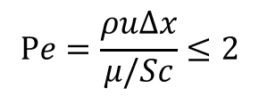
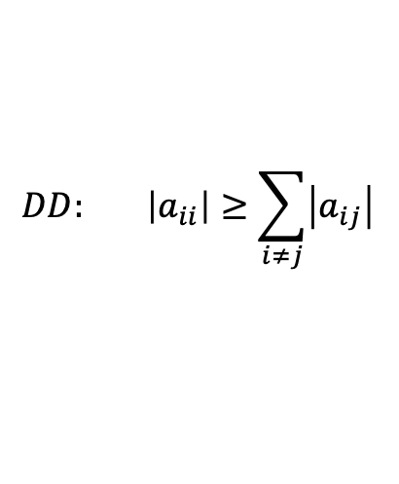
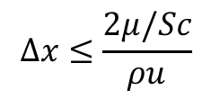
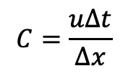
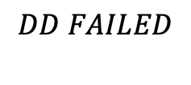
Diagonal Dominance Check
For a monotonic operator and ease of solving the linear system, , diagonal dominance is desired :
Consider u = 1 cm/s; ρ = 1.2e-3 g/cm3; μ/Sc = 1.8e-4 g/cm-s; Δx = 0.1 cm; ; Δt >> 1:
a_{j+1}=1.2e-5 a_{j-1}=2.4e-5 a_{j} = 3.6e-5
Stable and monotonic field will be realized; Re based on length scale = 0.67
Consider u = 10 cm/s; ρ = 1.2e-3 g/cm3; μ/Sc = 1.8e-4 g/cm-s; Δx = 0.1 cm; Δt >> 1:
a_{j+1}=-4.2e-5 a_{j-1}=7.8e-5 a_{j} = 3.605e-5
Unstable and lack of scalar monotonicity will be realized; Re based on length scale = 6.7
Standard preconditioner, e.g., SGS, are not expected to converge the linear system
Mesh spacing for monotonicity must be:
Cell Peclet number, Pe is a cell-Reynolds number based on local properties and mesh spacing
Consider u = 10 cm/s; ρ = 1.2e-3 g/cm3; μ/Sc = 1.8e-4 g/cm-s; Δx = 0.1 cm; Δt =?
For diagonal dominance, Δt = 0.0143 which corresponds to a Courant number of unity
$$DD: \left|a_{ii}\right|≥\sum_{i≠j}{\left|a_{ij}\right|}$$
$$DD PASSED$$
$$DD FAILED$$
$$Δx≤\frac{2μ/Sc}{ρu}$$
$$Pe=\frac{ρuΔx}{μ/Sc}≤2$$
$$C=\frac{uΔt}{Δx}$$

Slide 5
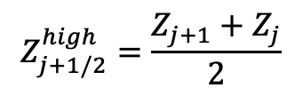
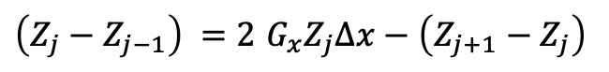
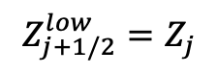
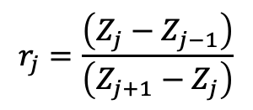
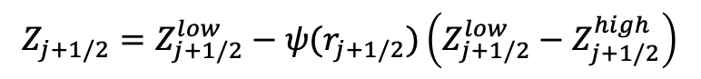
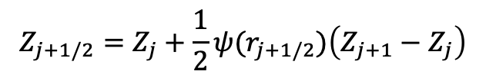
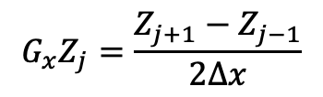
Classic Flux Limiters Van Leer, B. (1974), "Towards the ultimate conservative difference scheme II. Monotonicity and conservation combined in a second order scheme", J. Comput. Phys., 14 (4): 361–370
u_{x}
Consider our standard three-point stencil obtained by iterating edge 1 and 2
In the above stencil, we are stressing that when iterating edge 2, we do not have information easily obtain for edge 1 (shown above as a dotted line); (speaking from an unstructured perspective)
j-1
Z_{j-1/2}
j
Z_{j+1/2}
j+1
Edge 1
Edge 2
Let:
$$Z_{j+1/2}=Z_{j+1/2}^{low}−ψ(r_{j+1/2})\left(Z_{j+1/2}^{low}−Z_{j+1/2}^{high}\right)$$
$$Z_{j+1/2}^{low}=Z_{j}$$
$$Z_{j+1/2}^{high}=\frac{Z_{j+1}+Z_{j}}{2}$$
$$Z_{j+1/2}=Z_{j}+\frac{1}{2}ψ(r_{j+1/2})\left(Z_{j+1}−Z_{j}\right)$$
if
and
, then
$$r_{j}=\frac{\left(Z_{j}−Z_{j−1}\right)}{\left(Z_{j+1}−Z_{j}\right)}$$
Defining:
(with extrapolation)
$\left(Z_{j}−Z_{j−1}\right) =2$ $G_{x}Z_{j}∆x−\left(Z_{j+1}−Z_{j}\right)$
Recall:
$$G_{x}Z_{j}=\frac{Z_{j+1}−Z_{j−1}}{2∆x}$$

Slide 6
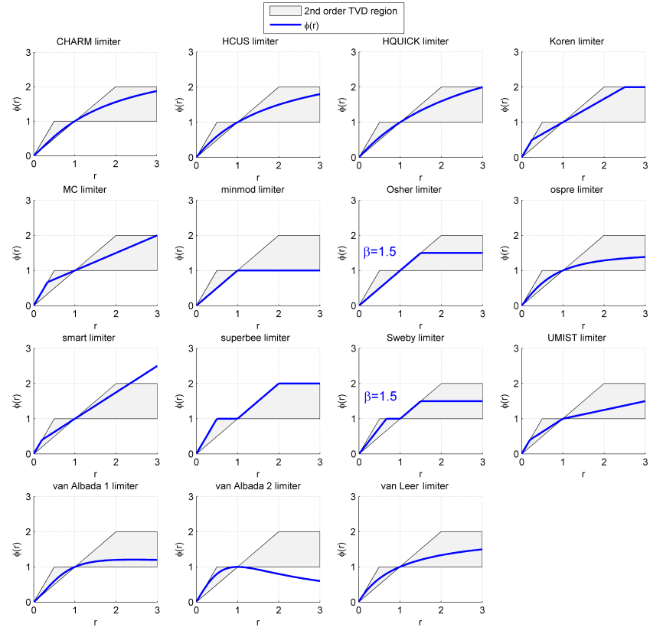
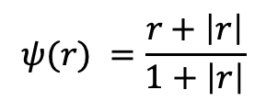
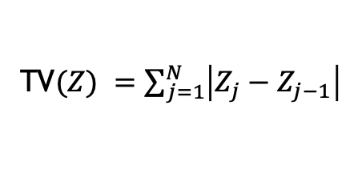
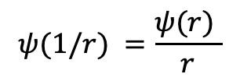
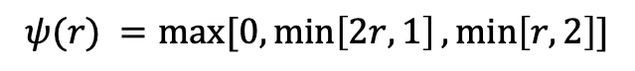
Flux Limiter Definition
Sweby (1984) defined set of permissible limiter regions for the desired second-order accurate methods: A sampling of the Sweby Diagram
For a monotonically increasing function, TV(Z) = |Z₁ −Z_{N} |. Note that if Z₁ and Z_{N} are taken constant, then, as long as the function remains monotonic the total variation is constant
However, if TV(Z) increases, then this suggest oscillations in the solution have occurred
Van Leer:
$$ψ(r) =\frac{r+\left|r\right|}{1+\left|r\right|}$$
Superbee:
$$ψ(r) =max⁡[0,\min\left[2r,1\right],\min\left[r,2\right]]$$
Symmetry Property:
Sweby's 2nd order TVD region. Created in Matlab. Griffgruff 18:37, 11 October 2006 (UTC)
$$ψ(1/r) =\frac{ψ(r) }{r}$$
Defining Total Variation (TV)
TV$(Z) =\sum_{j=1}^{N}{\left|Z_{j}−Z_{j−1}\right|}$

Slide 7
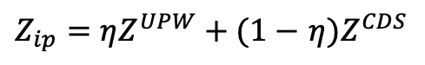
Strategy 1: Blending Upwind and Central
A classic advection stabilization approach is to use a Galerkin (or the central differencing scheme) operator blended with upwind.
Recall, that the Peclet number for an advection/diffusion equation speaks to the ratio of advective transport rate to diffusive transport rate.
In our early stability analysis, recall that monotonicity was only captured when the cell Peclet number was less that 2
We can write the integration point value used as a blended value between the upwind choice and the central operator
The functional form for η varies
In practice, most practical flows drive upwinding
$Z_{ip}=ηZ^{UPW}+(1−$ $η{)Z}^{CDS}$
Hyperbolic tangent with specification of transition and blending

Slide 8
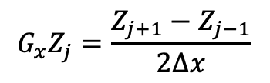
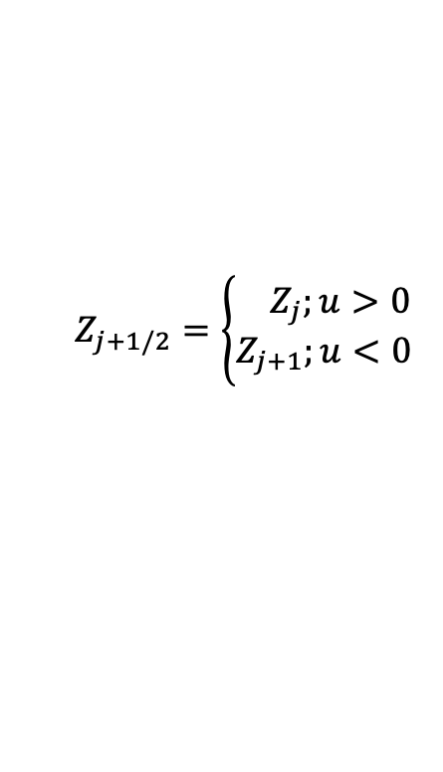
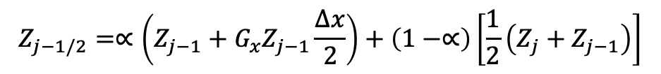
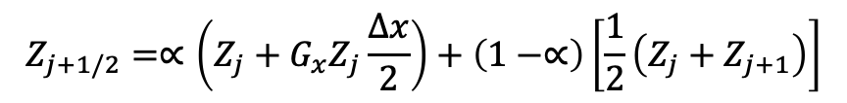
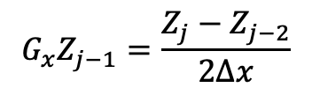
Unwinding to Create Pseudo-higher-order
Upwind advection operators can provide diagonal dominance (at the cost of accuracy)
However, upwind operators, even if higher-order, are numerically diffuse
Higher-order upwind (second-order in space) can be obtained on an unstructured mesh by use of projected nodal gradients and extrapolation:
j-1
Z_{j-1/2}
j
Z_{j+1/2}
j+1
$$Z_{j+1/2}=\left\{\begin{aligned}{ Z}_{j};u>0 \\ Z_{j+1};u<0\end{aligned}\right.$$
“as the wind blows”
$$G_{x}Z_{j}=\frac{Z_{j+1}−Z_{j−1}}{2∆x}$$
$$G_{x}Z_{j−1}=\frac{Z_{j}−Z_{j−2}}{2∆x}$$
$$Z_{j+1/2}=∝\left(Z_{j}+G_{x}Z_{j}\frac{∆x}{2}\right)+\left(1−∝\right)\left[\frac{1}{2}\left(Z_{j}+Z_{j+1}\right)\right]$$
α is a blending
parameter
for u>0
$$Z_{j−1/2}=∝\left(Z_{j−1}+G_{x}Z_{j−1}\frac{∆x}{2}\right)+\left(1−∝\right)\left[\frac{1}{2}\left(Z_{j}+Z_{j−1}\right)\right]$$

Slide 9
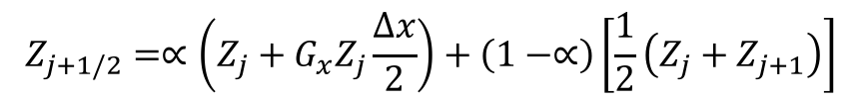
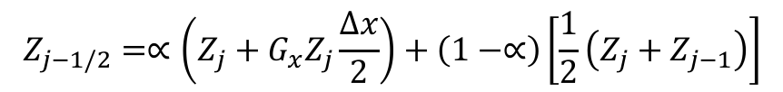
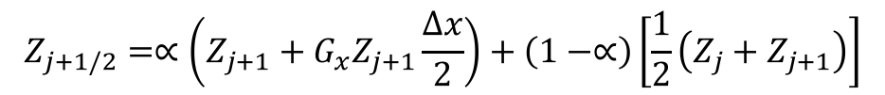
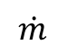
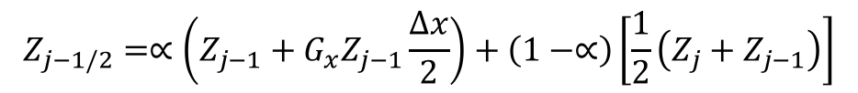
Pseudo Higher-order Upwind
Blending extrapolated upwind with central (Z_{L}+Z_{R})/2 provides:
Slope limiting required when gradients are not smooth (Berger et al, 2005, 43rd AIAA)
$$Z_{j+1/2}=∝\left(Z_{j}+G_{x}Z_{j}\frac{∆x}{2}\right)+\left(1−∝\right)\left[\frac{1}{2}\left(Z_{j}+Z_{j+1}\right)\right]$$
for u>0
$$Z_{j−1/2}=∝\left(Z_{j−1}+G_{x}Z_{j−1}\frac{∆x}{2}\right)+\left(1−∝\right)\left[\frac{1}{2}\left(Z_{j}+Z_{j−1}\right)\right]$$
$$Z_{j+1/2}=∝\left(Z_{j+1}+G_{x}Z_{j+1}\frac{∆x}{2}\right)+\left(1−∝\right)\left[\frac{1}{2}\left(Z_{j}+Z_{j+1}\right)\right]$$
for u<0
$$Z_{j−1/2}=∝\left(Z_{j}+G_{x}Z_{j}\frac{∆x}{2}\right)+\left(1−∝\right)\left[\frac{1}{2}\left(Z_{j}+Z_{j−1}\right)\right]$$
$$\dot{m}$$
j-2 | j-1 | j | j+1 | j+2 | α
1/4 | -5/4 | +3/4 | +1/4 | 0 | 1 | >0
0 | -1/4 | -3/4 | +5/4 | -1/4 | 1 | >0
+1/6 | -6/6 | +3/6 | +2/6 | 0 | 1/2 | <0
0 | -2/6 | -3/6 | +6/6 | -1/6 | 1/2 | <0
Resulting
1-D Stencil

Slide 10
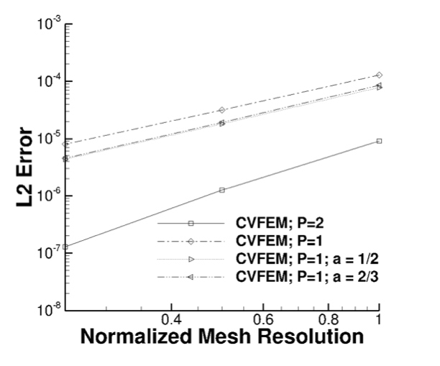
Pseudo Higher-order Upwind
Caveat: In practice, this method provides only a small shift in accuracy
Quadrature error dominated

Slide 11
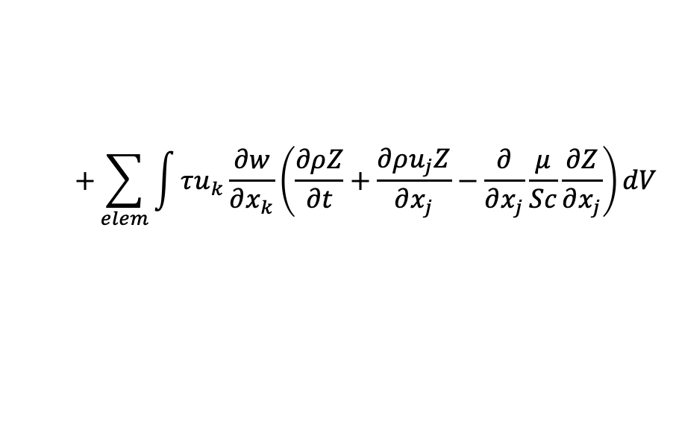
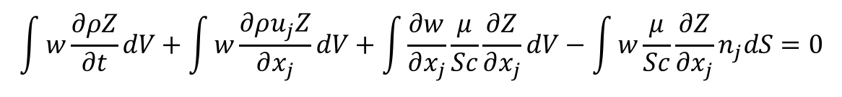
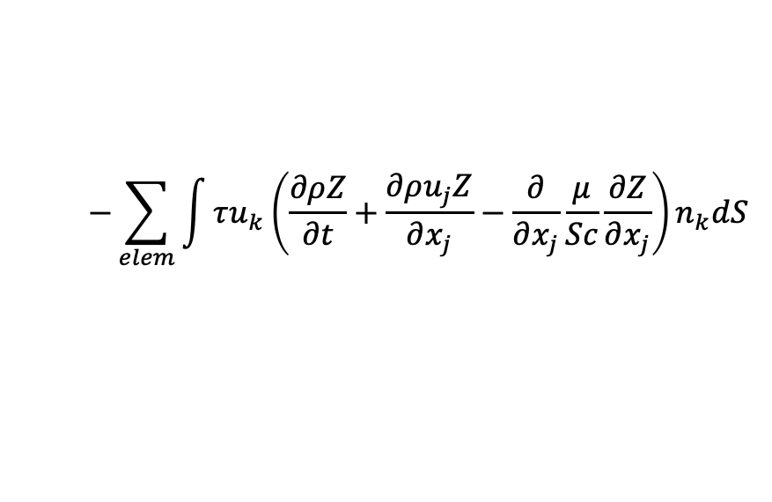
Linear Residual-Based Stabilization: FEM to CVFEM
Is there a better way that either un-stabilized (oscillatory and non-monotonic) and dissipative upwind?
Consider the model advection/diffusion PDE in the context of a FEM
Concept: Add a scaled fine-scale residual for stabilization, Streamwise Upwind Petrov Galerkin (Hughes and Brooks, 1982) – more generalized within the Variational Multiscale Method (VMS, Hughes et. al, 1998)
As noted earlier, CVFEM can be recovered by applying the piecewise-constant test function, w:
Godunuv’s theorem states that a linear stabilization approach is not sufficient to damp out all oscillations
$$\int{w\frac{∂ρZ}{∂t}dV+\int{w\frac{∂ρu_{j}Z}{∂x_{j}}}dV+\int{\frac{∂w}{∂x_{j}}}\frac{μ}{Sc}\frac{∂Z}{∂x_{j}}dV−\int{w}\frac{μ}{Sc}\frac{∂Z}{∂x_{j}}n_{j}dS=0}$$
$$+\sum_{elem}{\int{τu_{k}\frac{∂w}{∂x_{k}}\left(\frac{∂ρZ}{∂t}+\frac{∂ρu_{j}Z}{∂x_{j}}−\frac{∂}{∂x_{j}}\frac{μ}{Sc}\frac{∂Z}{∂x_{j}}\right)}}dV$$
$$−\sum_{elem}{\int{τu_{k}\left(\frac{∂ρZ}{∂t}+\frac{∂ρu_{j}Z}{∂x_{j}}−\frac{∂}{∂x_{j}}\frac{μ}{Sc}\frac{∂Z}{∂x_{j}}\right)n_{k}dS}}$$

Slide 12
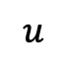
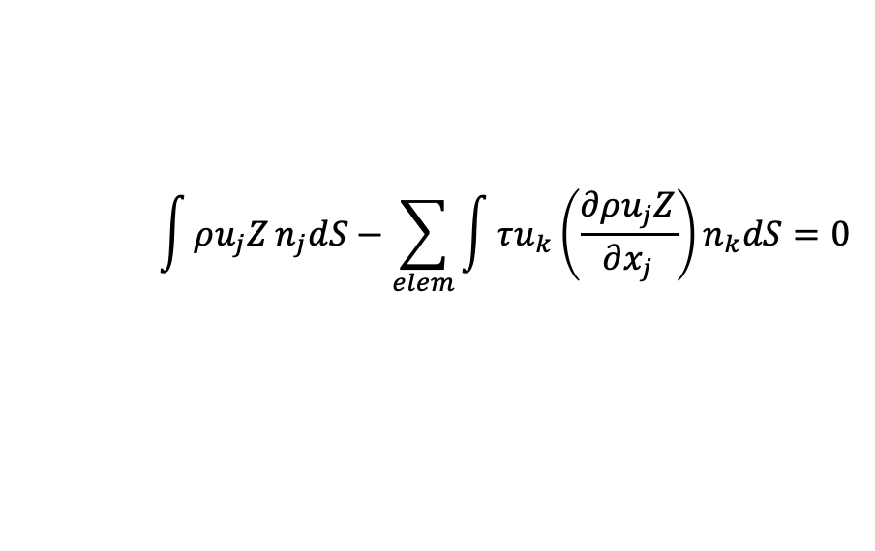
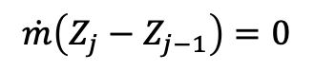
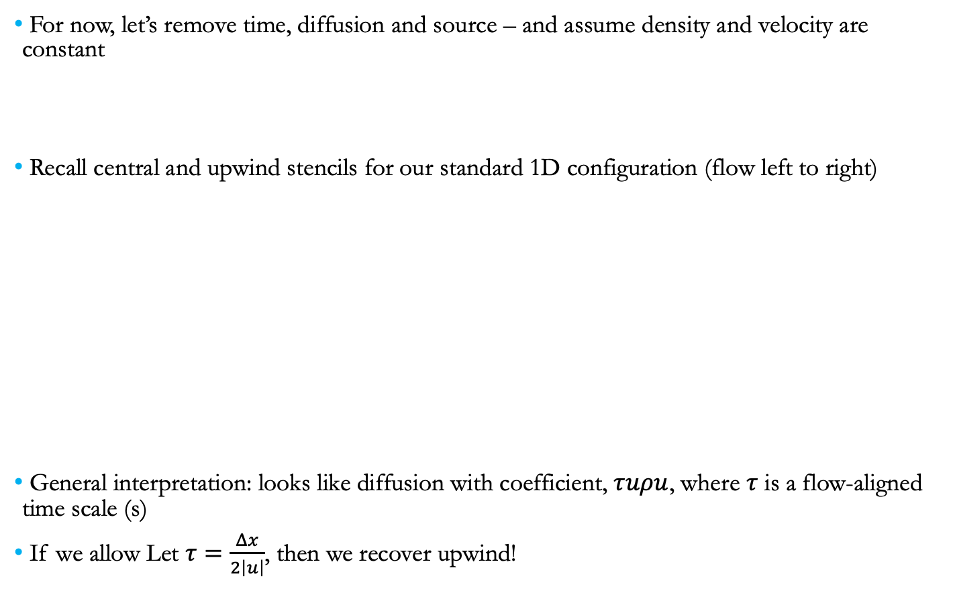
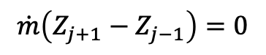
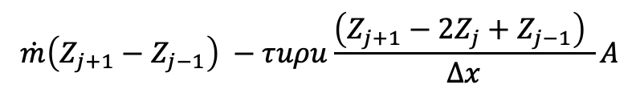
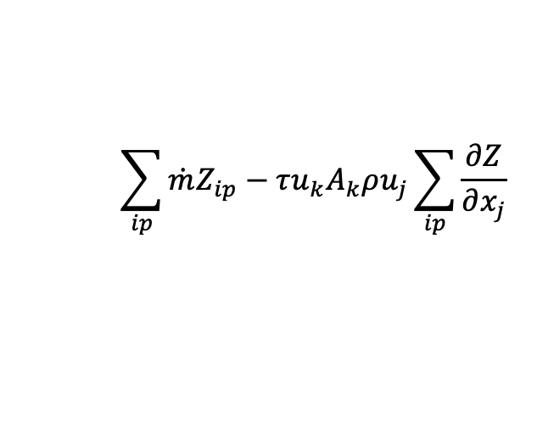
Linear Residual-Based Stabilization: CVFEM closer look
For now, let’s remove time, diffusion and source – and assume density and velocity are constant
Recall central and upwind stencils for our standard 1D configuration (flow left to right)
General interpretation: looks like diffusion with coefficient, $τuρu$, where $τ$ is a flow-aligned time scale (s)
If we allow Let $τ=\frac{Δx}{2\left|u\right|}$, then we recover upwind!
$$\int{ρu_{j}Z}n_{j}dS−\sum_{elem}{\int{τu_{k}\left(\frac{∂ρu_{j}Z}{∂x_{j}}\right)n_{k}dS=0}}$$
$$\sum_{ip}{\dot{m}Z_{ip}−τu_{k}A_{k}ρu_{j}\sum_{ip}{\frac{∂Z}{∂x_{j}}}}$$
$$\dot{m}\left(Z_{j+1}−Z_{j−1}\right)=0$$
$$\dot{m}\left(Z_{j}−Z_{j−1}\right)=0$$
j-1
Z_{j-1/2}
j
Z_{j+1/2}
j+1
_{A}
$$u$$
$$\dot{m}\left(Z_{j+1}−Z_{j−1}\right) −τuρu\frac{\left(Z_{j+1}−{2Z}_{j}+Z_{j−1}\right) }{Δx}A$$

Slide 13
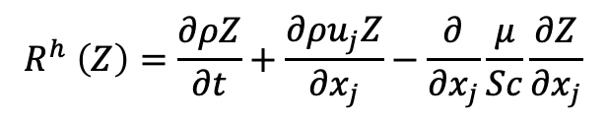



Linear Residual-Based Stabilization: Consistency?
The residual-based stabilization is given by,
with the fine-scale residual defined as,
Comments:
If the fine-scale residual is consistently evaluated, then as the mesh is refined the residual-based stabilization is removed
Recall that this is a linear stabilization scheme and may still admit oscillations
In the pure Finite Element Method description, this form of stabilization is a Petrov-Galerkin approach
with
$$\int{\frac{∂ρZ}{∂t}dV+\int{\left(ρu_{j}Z−\frac{μ}{Sc}\frac{∂Z}{∂x_{j}}\right)}n_{j}dS−\sum_{elem}{\int{τu_{k}n_{k}R^{h}(Z) dS}}}$$
$$R^{h} \left(Z\right)=\frac{∂ρZ}{∂t}+\frac{∂ρu_{j}Z}{∂x_{j}}−\frac{∂}{∂x_{j}}\frac{μ}{Sc}\frac{∂Z}{∂x_{j}}$$
$$\sum_{elem}{\int{\tilde{w}\left(\frac{∂ρZ}{∂t}+\frac{∂ρu_{j}Z}{∂x_{j}}−\frac{∂}{∂x_{j}}\frac{μ}{Sc}\frac{∂Z}{∂x_{j}}\right)}}dV=\sum_{elem}{\int{\tilde{w}R^{h}\left(Z\right) }}$$
$$\tilde{w}=w+τu_{k}\frac{∂w}{∂x_{k}}$$

Slide 14




SUPG in Practice (CVFEM and FEM)
SUPG and analog in CVFEM, Streamwise Upwind Control Volume (SUCV) are effective for low-moderate cell-Peclet numbers
Un-stabilized and SUPG
Convecting TV
SUPG/SUCV back step velocity prediction

Slide 15
What above Variational Multiscale Methods?
See:
https://nalu.readthedocs.io/en/latest/source/theory/rteStabilization.html

Slide 16
Nonlinear Stabilization Approach
Consider a general transport equation for φ
An artificial viscosity approach is provided with coefficient again related to a fine-scale residual:
Piecewise-constant test function for CVFEM (with fourth order-form)
Similar concept to Guermond’s “Entropy-viscosity” approach, 2013
Can also form an interesting LES model when the viscosity is a function of the k.e. fine scale residual (Guermond and Larios, 2015) – see Nalu theory for more information…
,
,
FEM-based DCO (Shakib, 91)
Co-variant and contra-variant metric tensors
or min…..
Coefficient based on local residual
Limit the coefficient based on an upwind analogy

Slide 17
Now, Direct Comparisons…
Transient scalar advection/diffusion transport (Re 2000); Mojtabi and Deville, Comput. Fluids, 2015

Slide 18
Now, Direct Comparisons, Order of Accuracy
Convecting Taylor/Vortex simulation at high crossflow velocity
Results demonstrate the ability to deploy this stabilization approach to high-order

Slide 19
Advection Operators: Conclusion
Without diagonal dominance, lack of monotonicity is noted
Upwind approaches can help, however, comes at the price of numerical accuracy
Residual-based approaches, which stem from the FEM literature, are useful candidates for CVFEM

